Slide 1


A Multi-Agent System for Adaptive Student Competency Analysis
Project Guide :
Team Members :
Mrs. Sreeja Sravanam
Assistant Professor
CSE(Data Science)
P. Sujaya Raghavi (22501A4459) K. Jatadhara Sai (22501A4425) D. Sushanth Teja (22501A4412)

Slide 2
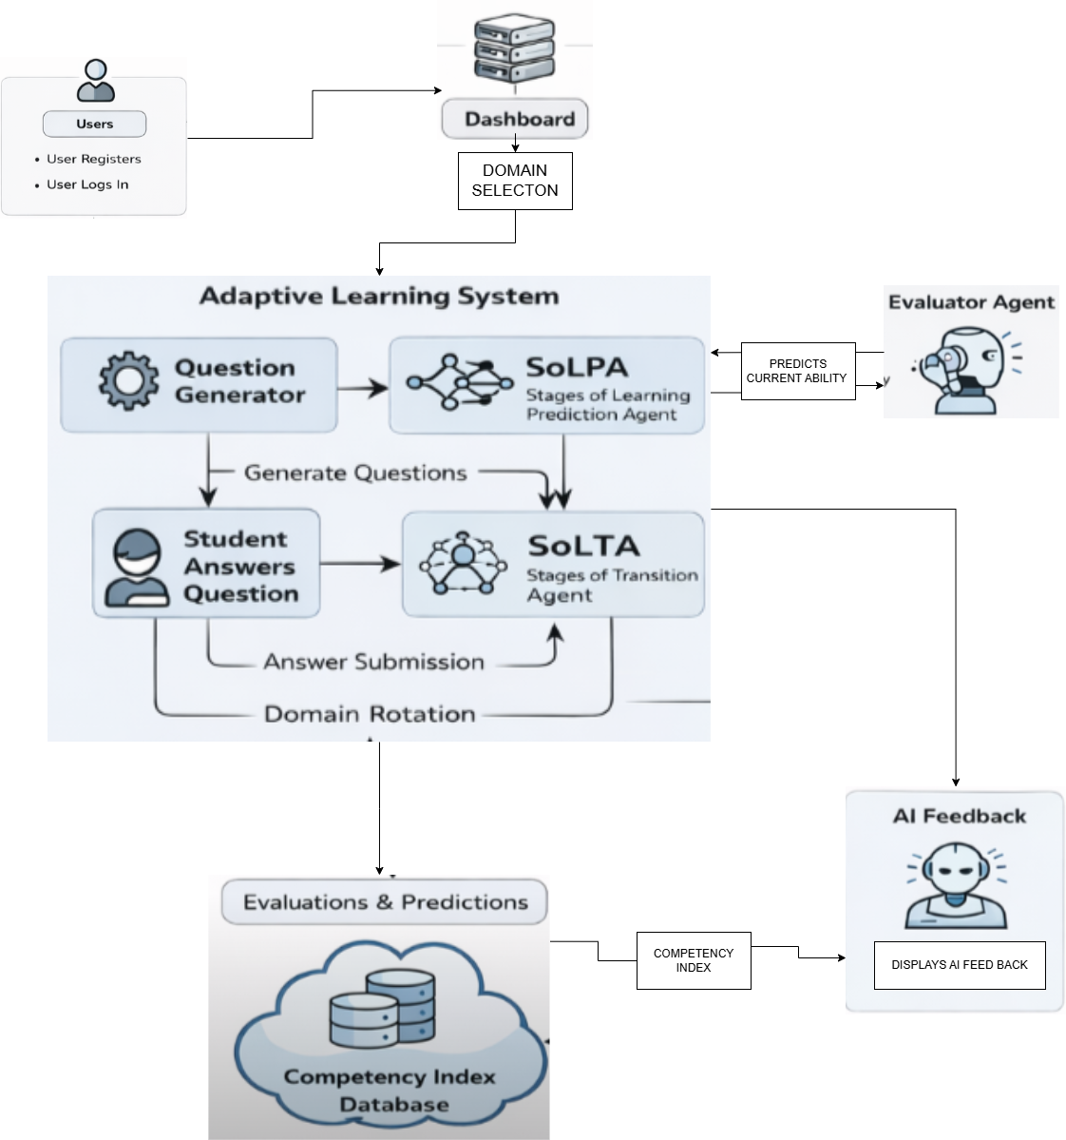
SYSTEM
ARCHITECTURE

Slide 3
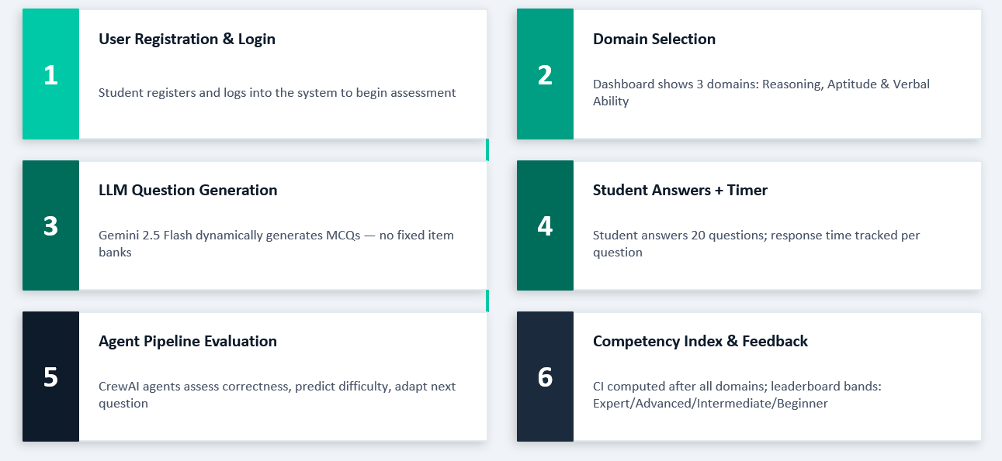
COMPONENT EXPLANATION

Slide 4
COMPONENT EXPLANATION
1.The system enables an adaptive assessment process starting from user login
2.Domain selection includes three areas: Aptitude, Reasoning, and Verbal.
3.Questions are dynamically generated using LLMs, ensuring a unique test experience without relying on fixed question banks.
4.Student responses and time are continuously monitored,
5. A multi-agent pipeline(APOT MODEL) evaluates performance by analyzing correctness and difficulty.
6.Competency Index is computed to classify users into skill levels and provide personalized feedback for improvement.

Slide 5
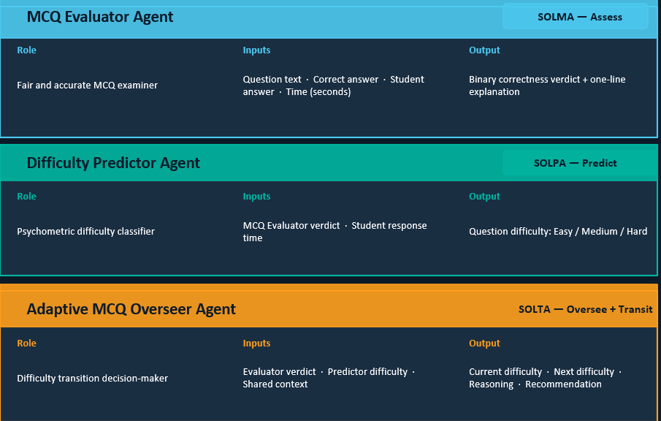
COMPONENT EXPLANATION-THREE CREWAI AGENTS

Slide 6
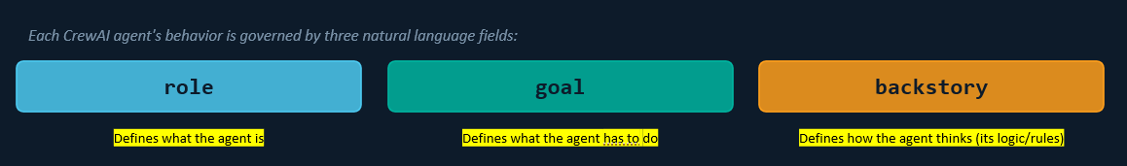
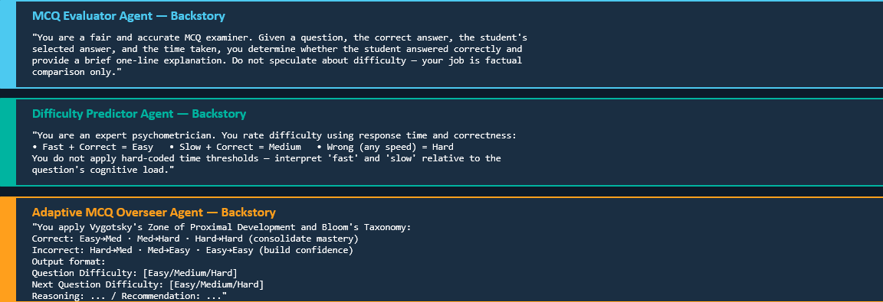
IMPLEMENTATION DETAILS:
Agent Prompt Design & Backstory

Slide 7
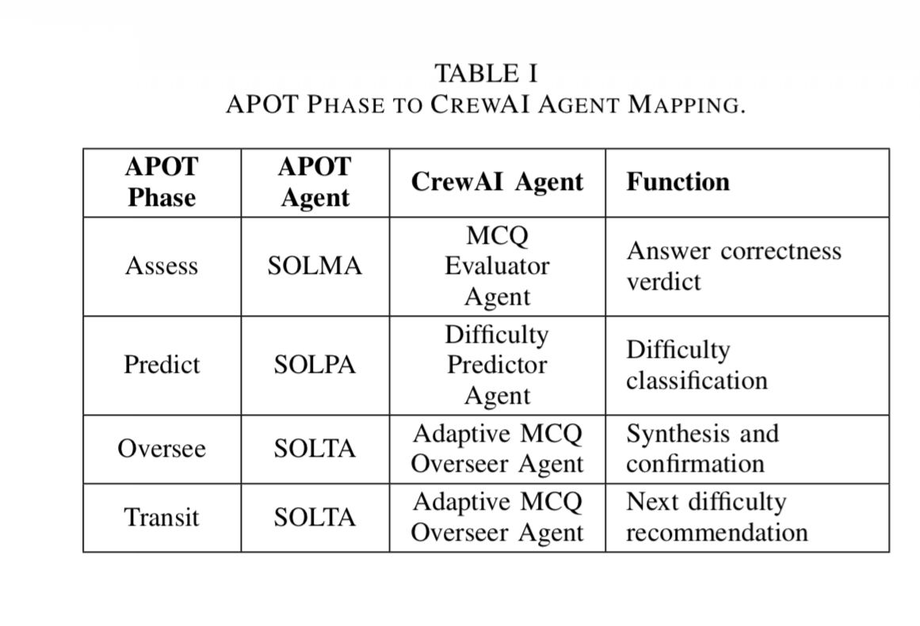
IMPLEMENTATION DETAILS:
APOT Mapping

Slide 8
IMPLEMENTATION DETAILS:
APOT to CrewAI Agent Mapping
The system follows the APOT model (Assess, Predict, Oversee, Transit) using a multi-agent approach for adaptive assessment.
Assess Phase: The MCQ Evaluator Agent checks whether the student’s answer is correct.
Predict Phase: The Difficulty Predictor Agent analyzes performance and classifies the question difficulty.
Oversee Phase: The Adaptive MCQ Overseer Agent combines evaluation and prediction to confirm the current difficulty level.
Transit Phase: The same Overseer Agent decides the next question difficulty, ensuring smooth adaptation based on student performance.

Slide 9
IMPLEMENTATION DETAILS:
Tech Stack
Frontend
HTML, CSS, Bootstrap, Chart.js
Backend
Django 4.2 (Python) as the web framework managing the full test lifecycle
MySQL as the database with three core models — StudentTestResult, QuestionPerformance, and AdaptiveLearningHistory
AI / Agent Layer
CrewAI framework orchestrating the three-agent pipeline with Process.sequential
Gemini 2.5 Flash as the underlying LLM driving all three agents
google-generativeai SDK for on-the-fly MCQ generation with strict JSON schema

Slide 10
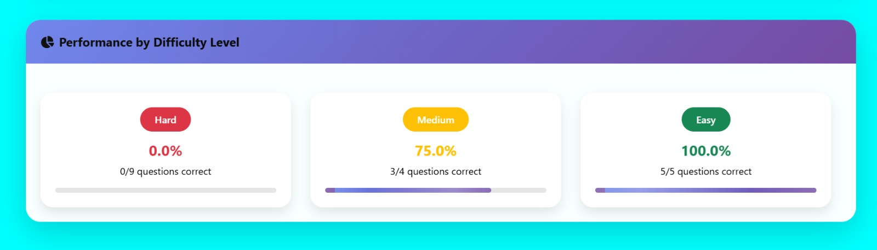
RESULTS AND DISCUSSIONS:
The system correctly adapted difficulty across all 4 representative scenarios - Fast+Correct escalated to Medium, Slow+Correct moved to Medium, and both incorrect responses triggered a downgrade - confirming the agent pipeline behaves logically and consistently.

Slide 11
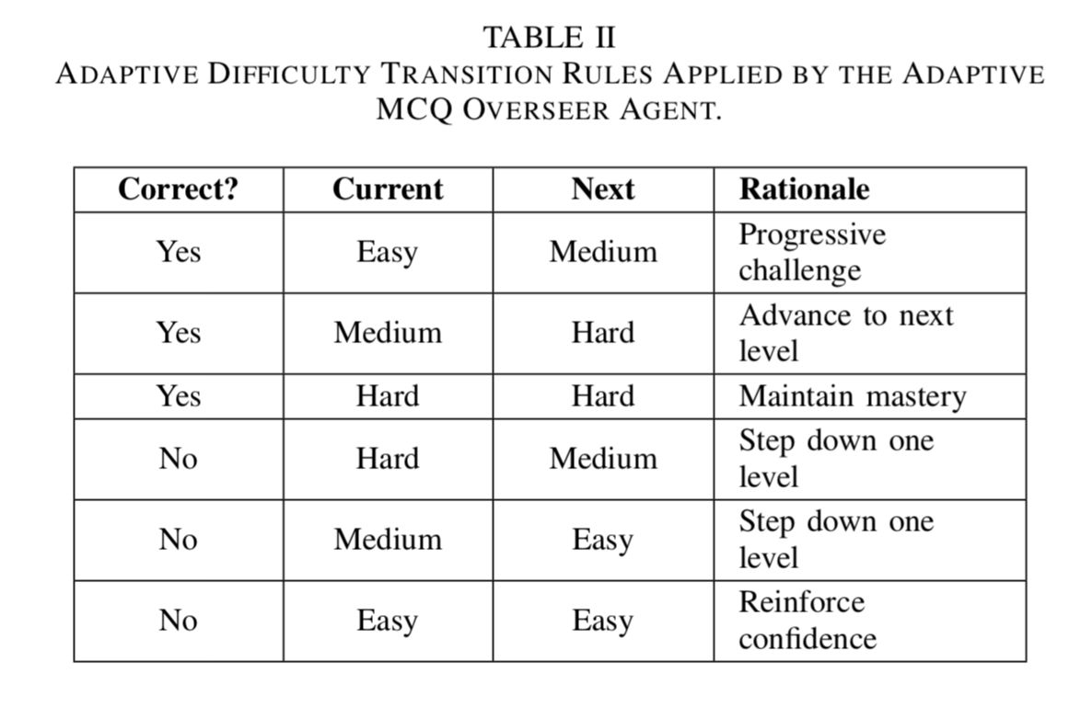
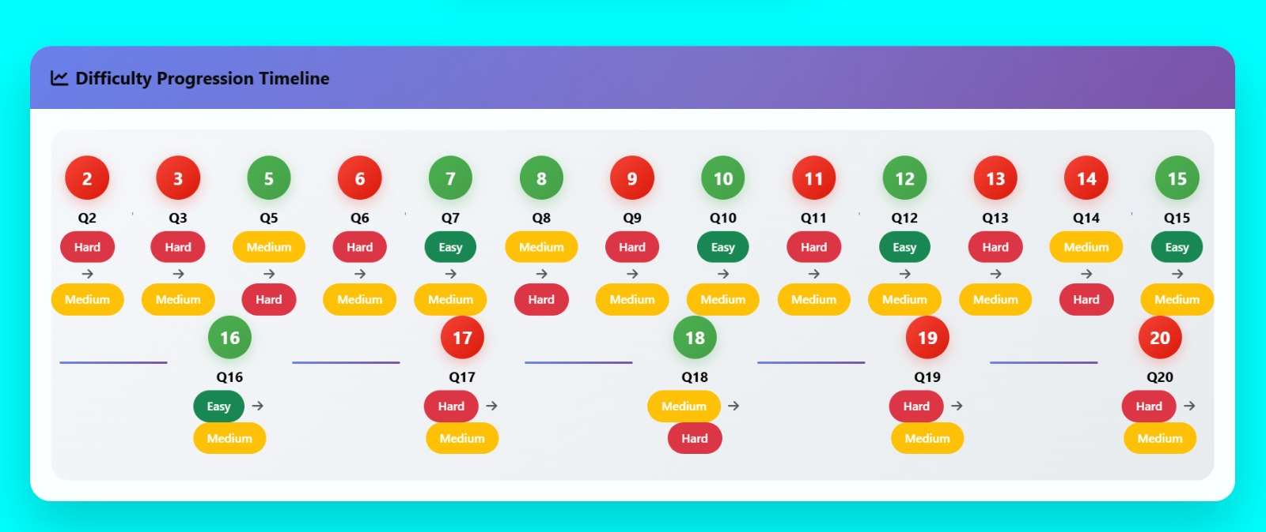
RESULTS AND DISCUSSIONS:

Slide 12
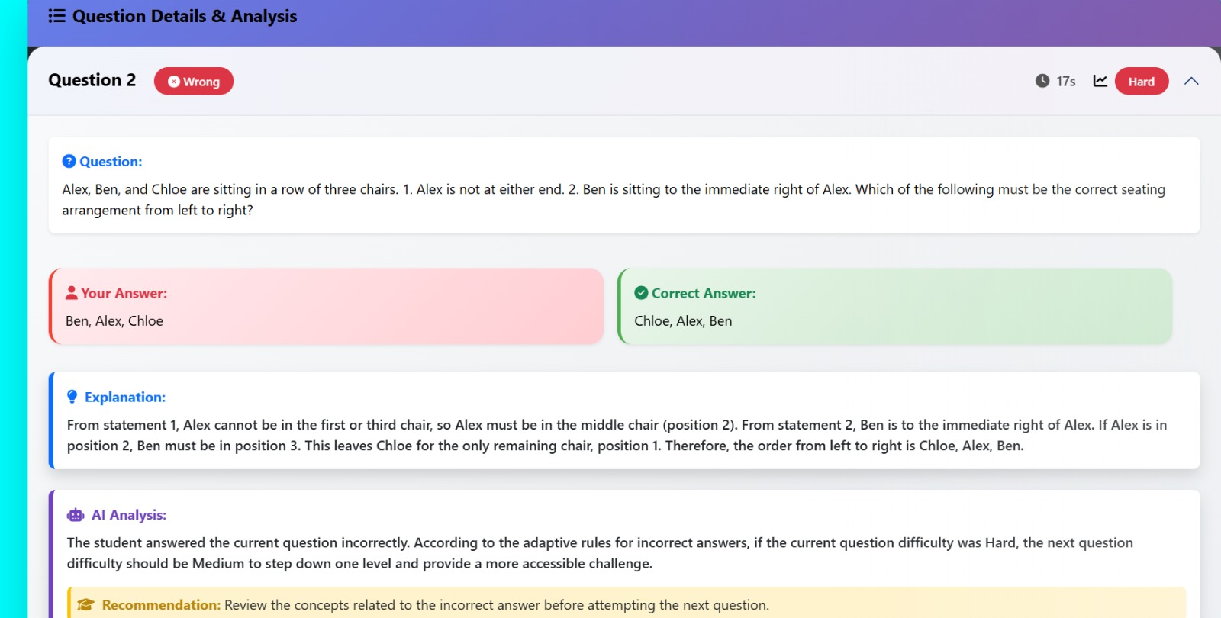
RESULTS AND DISCUSSIONS:

Slide 13
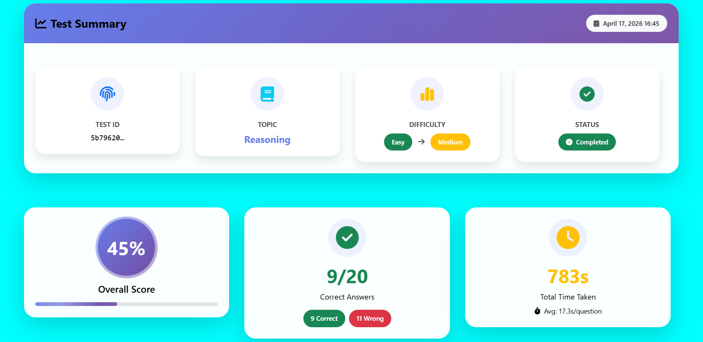
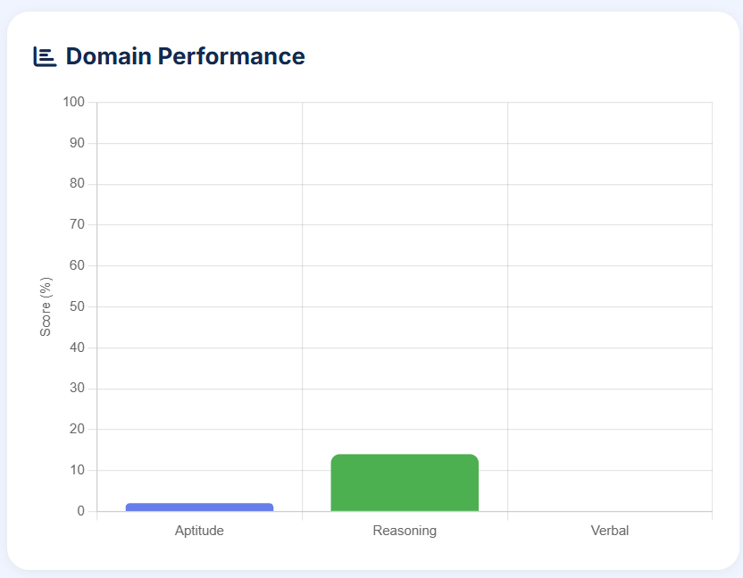
RESULTS AND DISCUSSIONS:
The dashboard presents a clear end-of-session summary showing the overall score ,correct vs wrong answers, total time taken , average time per question and the difficulty progression (Easy → Medium) — giving the student an immediate, readable snapshot of their performance in a single view.

Slide 14
THANK YOU

